Slide 1
Classification of Data Mining System

Slide 2
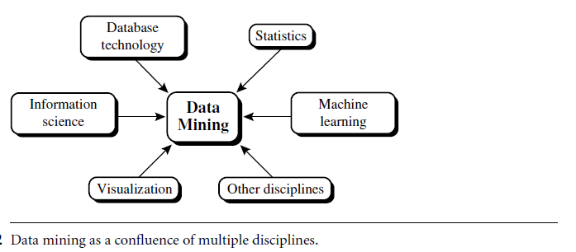
Data mining is an interdisciplinary field

Slide 3
Classification according to the kinds of databases mined
A data mining system can be classified according to the kinds of databases mined or data models.
relational, transactional, object-relational, or data warehouse mining system.
Classification according to the special types of data handled, we may have a spatial, time-series, text, stream data, multimedia data mining system, or a World Wide Web mining system.

Slide 4
Classification according to the kinds of knowledge mined
Data mining systems can be categorized according to the kinds of knowledge they mine / data mining functionalities
A data mining system usually uses multiple and integrated data mining functionalities.
Data mining systems can be distinguished based on the granularity or levels of abstraction of the knowledge mined.
Generalized knowledge (at a high level of abstraction), primitive-level knowledge (at a raw data level), or knowledge at multiple levels (considering several levels of abstraction).

Slide 5
Classification according to the kinds of techniques utilized
according to the degree of user interaction involved
autonomous systems,
interactive exploratory systems,
query-driven systems
methods of data analysis employed
database-oriented techniques
data warehouse oriented techniques
machine learning techniques
statistics
visualization
pattern recognition
neural networks

Slide 6
Classification according to the applications adapted
Finance
telecommunications
DNA
Stock markets,
e-mail

